Slide 1


Slide 2
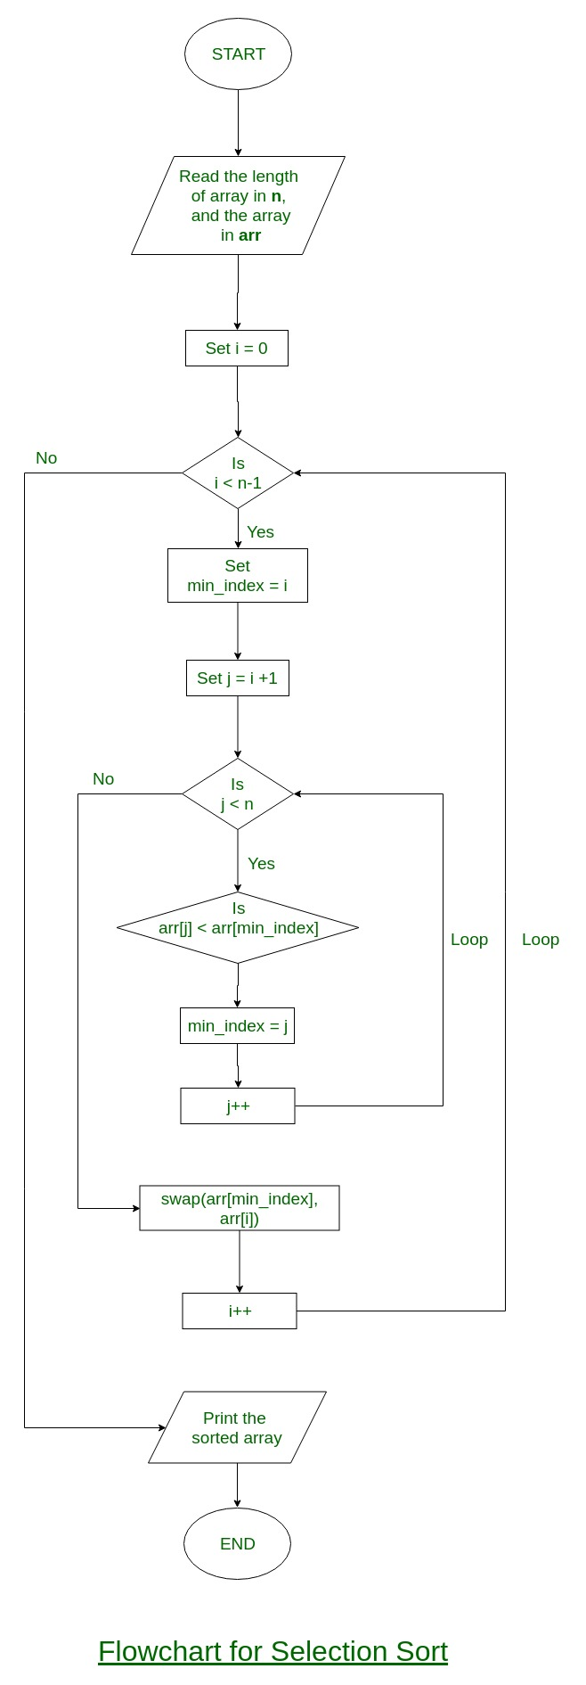
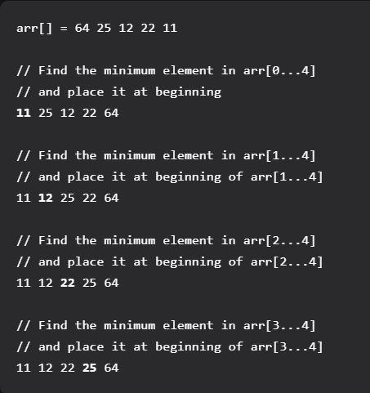
SELECTION SORT
The selection sort algorithm sorts an array by repeatedly finding the minimum element ascending order from unsorted part and putting it at the beginning
Time Complexity: O(n2) as there are two nested loops.
Notes:
https://youtu.be/xWBP4lzkoyM

Slide 3
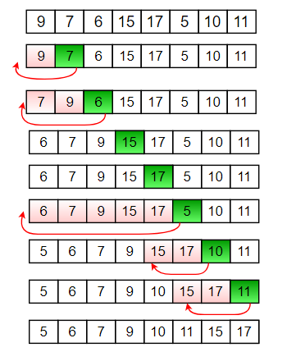
INSERTION SORT
To sort an array of size n in ascending order: 1: Iterate from arr[1] to arr[n] over the array. 2: Compare the current element (key) to its predecessor. 3: If the key element is smaller than its predecessor, compare it to the elements before. Move the greater elements one position up to make space for the swapped element.
Time Complexity: O(n^2)
Uses: Insertion sort is used when number of elements is small. It can also be useful when input array is almost sorted, only few elements are misplaced in complete big array.
Notes:
https://youtu.be/OGzPmgsI-pQ

Slide 4
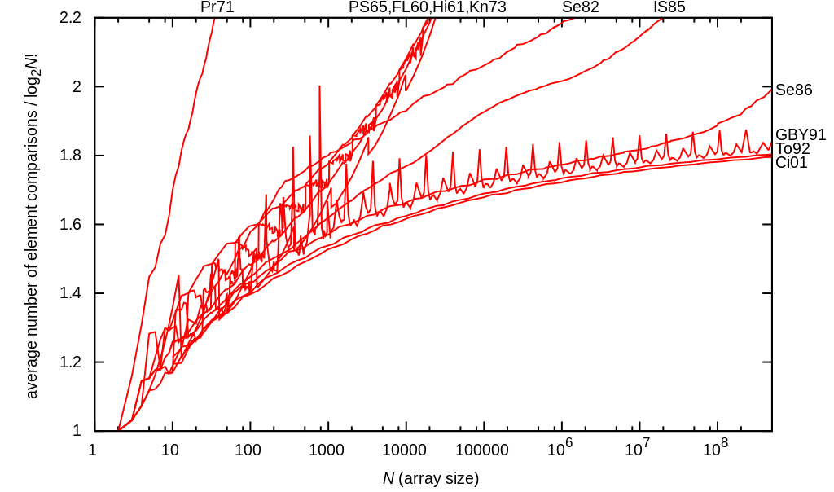
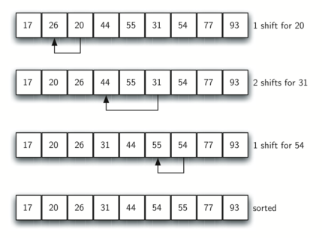
SHELL SORT
ShellSort is mainly a variation of Insertion Sort. In insertion sort, we move elements only one position ahead. When an element has to be moved far ahead, many movements are involved. The idea of shellSort is to allow exchange of far items. In shellSort, we make the array h-sorted for a large value of h. We keep reducing the value of h until it becomes 1. An array is said to be h-sorted if all sublists of every h’th element is sorted.
Time Complexity: Time complexity of above implementation of shellsort is O(n2).
In the above implementation gap is reduce by half in every iteration. There are many other ways to reduce gap which lead to better time complexity.
Notes:
https://youtu.be/SHcPqUe2GZM

Slide 5
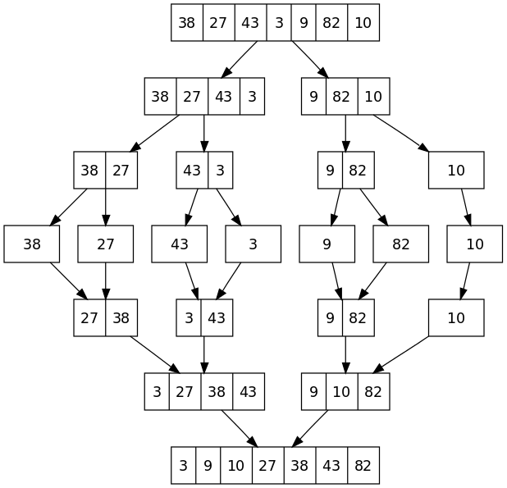
MERGE SORT
Merge Sort is a Divide and Conquer algorithm. It divides the input array into two halves, calls itself for the two halves, and then merges the two sorted halves. The merge() function is used for merging two halves. The merge(arr, l, m, r) is a key process that assumes that arr[l..m] and arr[m+1..r] are sorted and merges the two sorted sub-arrays into one.
Time Complexity: Sorting arrays on different machines. Merge Sort is a recursive algorithm and time complexity can be expressed as following recurrence relation. T(n) = 2T(n/2) + θ(n)
- Slower comparative to the other sort algorithms for smaller tasks.
Merge sort algorithm requires an additional memory space
of 0(n) for the temporary array.
- It goes through the whole process even if the array is sorted.
Notes:
https://youtu.be/JSceec-wEyw

Slide 6
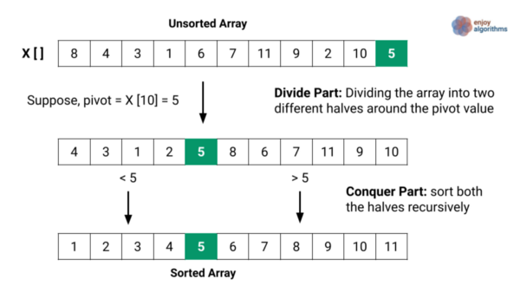
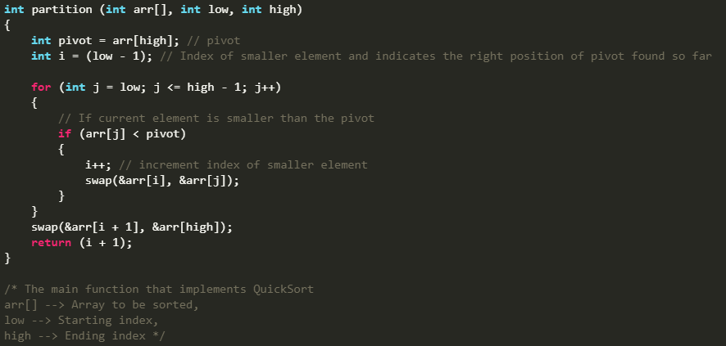
QUICKSORT
Like Merge Sort, QuickSort is a Divide and Conquer algorithm. It picks an element as pivot and partitions the given array around the picked pivot. There are many different versions of quickSort that pick pivot in different ways.
The key process in quickSort is partition(). Target of partitions is, given an array and an element x of array as pivot, put x at its correct position in sorted array and put all smaller elements (smaller than x) before x, and put all greater elements (greater than x) after x. All this should be done in linear time.
Notes:
https://youtu.be/PgBzjlCcFvc

Slide 7

ANY QUESTIONS ?
Made by : Huseyn Ahmedov P201

